Slide 1
Θ Notation

Slide 2
Agenda
Introduction
Graph

Slide 3
Introduction
It provides a tight bound of f(n) function to a constant factor within.
Given functions f(n) and g(n), we say that f(n) is Θ(g(n)) if there exists positive constants c₁ , c₂ and n₀ such that for every n ≥ n₀
Then, we have 0 ≤ c₁g(n)≤ f(n) ≤ c₂g(n)

Slide 4
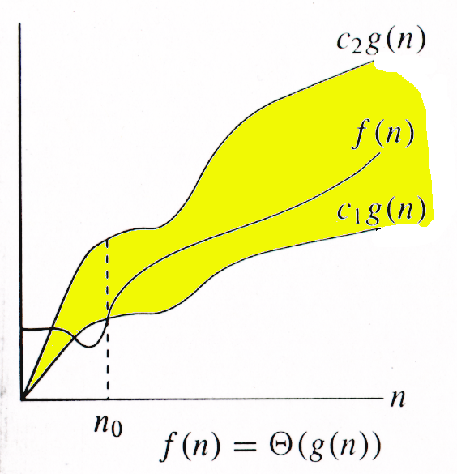
Graph
Example
10n² - 3n = Θ(n²)
n²/2 - 3 n = Θ(n²)

Slide 5
Summary
We have learned about Θ Notation, along with example.
Θ notation provides tight bound of f(n) function to a constant factor within.

Slide 6
Thank You
Proprietary content. ©Great Learning. All Rights Reserved. Unauthorized use or distribution prohibited

